Slide 1

SOFTWARE ENGINEERING AND PROJECT MANAGEMENT (CSE 227)
Department of Computer Science and Engineering
School of Engineering,
PRESIDENCY UNIVERSITY

Slide 2
Module 4: Software Project Management (13 hrs) – Application level
Project Management Concepts, Project Planning, Overview of metrics, Estimation for Software projects, Project Scheduling, Risk Management, Maintenance and Reengineering, Software Process Improvement (SPI): CMM Levels.

Slide 3
Module 4: Software Project Management (13 hrs) – Application level
Project Management Concepts, Project Planning, Overview of metrics, Estimation for Software projects, Project Scheduling, Risk Management, Maintenance and Reengineering, Software Process Improvement (SPI): CMM Levels.

Slide 4
R&D SDM 1 Software Process Improvement Capability Maturity Models
2010
Theo Schouten

Slide 5
Content
Process, product, people, quality
What are maturity models?
CMMI models
Operational use of the CMMI
People-CMM
Book chapter 2: Process: A Generic View
7: chapter 30 new

Slide 6
Process and product quality
A good process is usually required to produce a good product.
Improvement of the process give benefits because the quality of the product depends on its development process.
For industrial production, process is the principal quality determinant.
For design-based activities, the capabilities of the designers are also an important factor

Slide 7
Principal product quality factors
De
v
elopment
technolo
g
y
Pr
ocess
Pr
oduct
P
eople
quality
quality
quality
Cost, time and
schedule

Slide 8
Software Process Improvement stages
Process measurement
Attributes of the current process are measured. These are a baseline for assessing improvements
Process analysis
The current process is assessed and bottlenecks and weaknesses are identified
Process change
Changes to the process that have been identified during the analysis are introduced

Slide 9
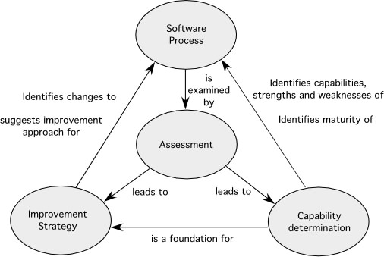
Elements of an SPI framework

Slide 10
What is a maturity model?
‘A maturity model is a model with which organizations can judge their (software engineering, hrm, service, etc.) process (including comparing it to other organizations) and based on this judgment can improve their process.’
started in 1986 by the Software Engineering Institute (SEI) (Carnegie Mellon University) and the Mitre Corporation
SEI started with a Process Maturity Framework and a maturity questionnaire
the software Framework developed into the Capability Maturity Model (CMM) for Software (1991)
Revised maturity framework (CMMI) introduced in 2001

Slide 11
Process Maturity Framework
Goal is the improvement of the software engineering process
Success should not be based on incidental individual achievements
Success should be based on repeatable and proven successful work methods
Immature
Software
Organization
Mature
Software
Organization
No objective basis for judgment of product quality
No objective basis for improvement of product or process quality
Reviews and tests are often skipped when projects run behind schedule
Ad hoc management
Organization wide knowledge to manage software development, employment and improvement
Processes are ‘fit-for-use’
Processes are being adapted to the situation
Tasks and responsibilities are clear for the project and anyone in the organization

Slide 12
Software Process
Software Process:
‘the whole of activities, methods, practices, communication and changes that people use in order to develop and maintain software and associated products (e.g. plans, design documents, code, test cases and user manuals)’
CMM gives an organization a way
to get and improve control over the software
process and provides it with a route to achieve excellence
in software engineering

Slide 13
Fundamental concepts for Process Maturity
Software Process Capability
How good it can predict the expected outcome of a next software project
Software Process Performance
Actual results of a software project
Software Process Maturity
The level in which a software process is explicitly defined, managed, measured and controlled in order to achieve results
Software Process Institutionalization
The level in which the software process is institutionalized with respect to methods, standards and organizational structure

Slide 14
Levels of software maturity
Maturity level:
A well defined level on the way to achieve an adult, a mature software process
A foundation for realizing continuous improvements
Every level contains a group of process goals that, when stable, form an important part of the software process
Every level leads to the improvement of the process capability of the organization

Slide 15
The staged CMMI model

Slide 16
Initial (1)
The software process can be described as ad-hoc, or even chaotic
There are practically no processes defined
Success depends on individual input and achievements
The software process is not predictable regarding results
Schedules, budget, functionality and product quality is not predictable
Works disastrous in crises situations
Can be successful in highly innovative environment (e.g. start of the web-design world)

Slide 17
Managed (2)
The basic project management procedures are used
Costs, schedules en functionality are ‘tracked’
Planning and managing of new projects are based on experience with comparable projects
Needed process discipline is enforced such that earlier success can be repeated with building an comparable application
Software requirements and work products are ‘baselined’
Disciplined environment in which planning and tracking are stable and thus previous successes can be repeated

Slide 18
Defined (3)
Processes for management and software engineering are documented, standardized and integrated in a standard software development process
All projects use an approved, adapted version of the standard software process for the development and maintenance of software
Processes are used to let software managers and engineers be more effective
There is a group responsible for the software process
There is training in the software process
The software process is stable and well defined and is able to operate more effectively

Slide 19
Quantitatively managed (4)
Detailed metrics of the software processes and quality of products are gathered
Quantitative goals are set for the software process and the product quality
Use is made of a software process database in which the metrics are gathered and analyzed
Projects have a control over the software process and product quality such that the can work in defined limits
Risks of development in new technical environments are recognized and managed
Software process is predictable and trends can be predicted

Slide 20
Optimizing (5)
Continuously software process improvements are realized by quantitatively feedback of the process and by trying out of innovative ideas and technologies
The whole organization is focused on continuous improvement
Data regarding performance of the processes are used for cost-benefit analyses
Innovations that make use of the best software engineering practices are identified and spread over the whole organization
Software project teams analyze errors in order to find out how to improve
‘Lessons learned’ are shared with other projects (team rooms, Communities of Practice)

Slide 21
Maturity level and changing predictability
Chance
Goal N-z
Level 5: Optimizing
Chance
Goal N-y
Level 4: Quantitatively Managed
Chance
Goal N-x
Level 3: Defined
Chance
Goal N+a
Level 2: Managed
Chance
Goal N
Level 1: Initial
Time/Money/…

Slide 22
Operational use of CMM
How do you determine in practice the maturity of an organization?
Maturity
Level
Indicate
Contain
Process
Capability
Key Process
Areas
Achieve
Organized by
Goals
Common
Features
Address
Contain
Implementation or
Institutionalization
Key
Practices
Describe
Infrastructure or
Activities

Slide 23
Key Process Areas
Optimizing (5)
Process change management
Technology change management
Defect prevention
Quantitatively
Managed (4)
Software quality management
Quantitative process management
Peer reviews
Intergroup coordination
Software product engineering
Integrated software management
Training program
Organization process definition
Organization process focus
Defined (3)
Managed (2)
Software Configuration Management
Software Quality Assurance
Software Subcontract Management
Software project tracking & oversight
Software project planning
Requirements Management
Initial (1)

Slide 24
Example
Maturity Level 2
Managed
Indicates
Contains
Key Process Area
Disciplined
Processes
Software
Project Planning
Achieves
Organized by
Common
Feature
Software estimates are
documented for use
in planning and tracking
Activities
Performed
Address
Contain
Key Practice
Implementation
Activity 9. Estimates for the size of the
software work products (or changes to it)
are derived according to
a documented procedure
Describe
Activity

Slide 25
Continuous CMM model
Project monitoring
and control
Supplier ag
reement
management
Risk
management
Configuration
management
Requirements
management
V
erification
V
alidation
1
2
3
4
5
A process capability profile

Slide 26
Remarks
Maturity Models are helpful to indicate the maturity of a software organization
The CMM(I) model is the most used
Organizations ‘benchmark’ themselves to position them relative to others based on the CMM-level
CMM-level should give an indication of the quality level of a software organization
Specially “new” countries (India, China) qualify themselves strongly in this area
It is not a “sacred cow” and it should be used prudently

Slide 27
Problems with CMM
CMM is actually a management framework, with many details left out (a goal, not a method)
Example: “You must have peer reviews.” But how should the reviews be run?
Being used just as stamp of approval
Just tell us what to do to get Level 2, so we can get back to work
Let’s work together to improve our software processes
Doesn’t say anything about software!
CMM is a model for managing software projects
Doesn’t help in a crisis
Only for repetitive tasks

Slide 28
People- Capability Maturity Model (P-CMM)
Improvement of the capabilities of the software organization by improvement of the skills of the individuals
Assure that the ability in software development is an attribute of the organization and not of a number of individuals
Keeping people with critical knowledge and skills in the organization
Assure that the goals and direction of the individuals is the same as that of the organization

Slide 29
Provides
A framework that focuses on improving management and development of human assets of an organization.
Provides an improvement path
Integrate workforce development with process improvement
Characterize the maturity of their workforce practices

Slide 30
Trends Affecting the Workforce
Pfeffer (1994)
Doers differ from thinkers -> Doers must be thinkers
Assets are things -> Assets are people
Labor is an expense -> People are an investment
Lifetime employment -> Lifetime employability
Top down control -> Decentralized decisions
Localized work -> Networked problems solved
Measure for results -> Measure for improvements

Slide 31
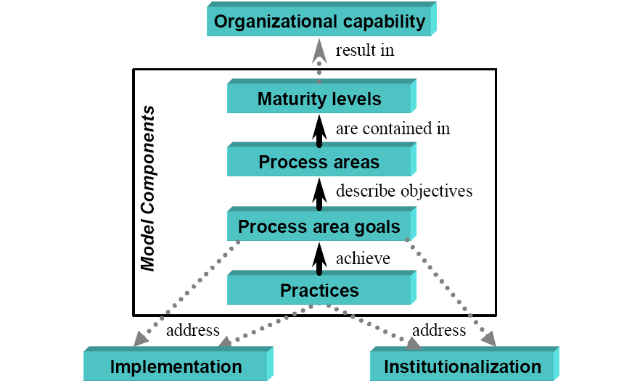
P-CMM Architecture

Slide 32
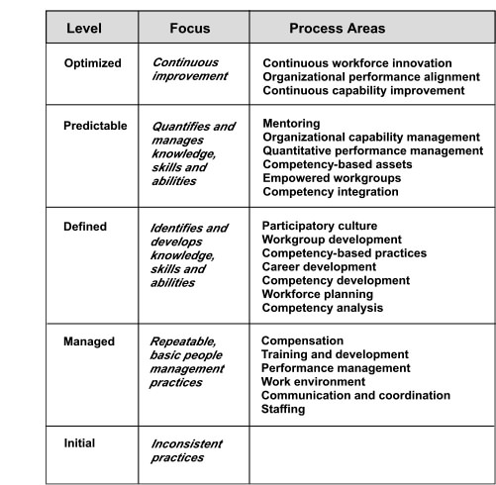
P-CMM levels and process areas

Slide 33
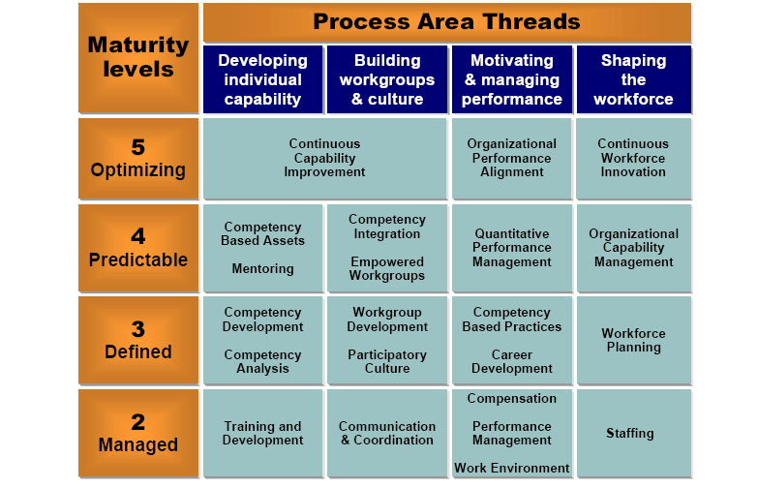
Process Area & Maturity Levels

Slide 34
Process Goals & Process Practice
Process area goal is an organizational state to be achieved by implementing the practices of a process area.
Process practice is a sub process within a process area that contributes to achieving a process area goal.

Slide 35
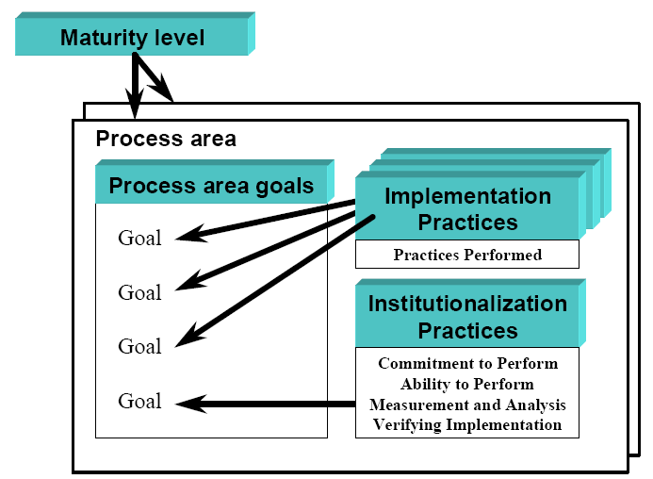
Implementation & Institutionalization Practices

Slide 36
Other SPI frameworks
SPICE— a international initiative to support the International Standard ISO/IEC 15504 for (Software) Process Assessment [ISO08]
Bootstrap—a SPI framework for small and medium sized organizations that conforms to SPICE [Boo06],
PSP and TSP—individual and team specific SPI frameworks ([Hum97], [Hum00]) that focus on process in-the-small, a more rigorous approach to software development coupled with measurement
TickIT—an auditing method [Tic05] that assesses an organization compliance to ISO Standard 9001:2000

Slide 37
SPI trends
future SPI frameworks must become significantly more agile
Rather than an organizational focus (that can take years to complete successfully), contemporary SPI efforts should focus on the project level
To achieve meaningful results (even at the project level) in a short time frame, complex framework models may give way to simpler models.
Rather than dozens of key practices and hundreds of supplementary practices, an agile SPI framework should emphasize only a few pivotal practices

